Slide 1
Zadaci sa ispita
Jun 2018.

Slide 2
6. zadatak
Koristeći Knuth-Morris-Pratt algoritam opisati postupak traženja podstringa cbca u stringu cccbcbcbccccacbcbcacca.

Slide 3
6. zadatak
Preprocesiranje:
j | 0 | 1 | 2 | 3
P[j] | c | b | c | a
π[j] | 0 | 0 | 1 | 0

Slide 4
c | c | c | b | c | b | c | b | c | c | c | c | a | c | b | c | b | c | a | c | c | a
c | b | c | a
c | c | c | b | c | b | c | b | c | c | c | c | a | c | b | c | b | c | a | c | c | a
c | b | c | a
π[0] = 0
c | c | c | b | c | b | c | b | c | c | c | c | a | c | b | c | b | c | a | c | c | a
c | b | c | a
c | c | c | b | c | b | c | b | c | c | c | c | a | c | b | c | b | c | a | c | c | a
c | b | c | a
π[0] = 0
c | c | c | b | c | b | c | b | c | c | c | c | a | c | b | c | b | c | a | c | c | a
c | b | c | a

Slide 5
c | c | c | b | c | b | c | b | c | c | c | c | a | c | b | c | b | c | a | c | c | a
c | b | c | a
c | c | c | b | c | b | c | b | c | c | c | c | a | c | b | c | b | c | a | c | c | a
c | b | c | a
c | c | c | b | c | b | c | b | c | c | c | c | a | c | b | c | b | c | a | c | c | a
c | b | c | a
π[2] = 1
c | c | c | b | c | b | c | b | c | c | c | c | a | c | b | c | b | c | a | c | c | a
c | b | c | a
c | c | c | b | c | b | c | b | c | c | c | c | a | c | b | c | b | c | a | c | c | a
c | b | c | a
c | c | c | b | c | b | c | b | c | c | c | c | a | c | b | c | b | c | a | c | c | a
c | b | c | a
π[2] = 1

Slide 6
c | c | c | b | c | b | c | b | c | c | c | c | a | c | b | c | b | c | a | c | c | a
c | b | c | a
c | c | c | b | c | b | c | b | c | c | c | c | a | c | b | c | b | c | a | c | c | a
c | b | c | a
c | c | c | b | c | b | c | b | c | c | c | c | a | c | b | c | b | c | a | c | c | a
c | b | c | a
π[2] = 1
c | c | c | b | c | b | c | b | c | c | c | c | a | c | b | c | b | c | a | c | c | a
c | b | c | a
π[0] = 0
c | c | c | b | c | b | c | b | c | c | c | c | a | c | b | c | b | c | a | c | c | a
c | b | c | a
c | c | c | b | c | b | c | b | c | c | c | c | a | c | b | c | b | c | a | c | c | a
c | b | c | a
π[0] = 0

Slide 7
c | c | c | b | c | b | c | b | c | c | c | c | a | c | b | c | b | c | a | c | c | a
c | b | c | a
c | c | c | b | c | b | c | b | c | c | c | c | a | c | b | c | b | c | a | c | c | a
c | b | c | a
π[0] = 0
c | c | c | b | c | b | c | b | c | c | c | c | a | c | b | c | b | c | a | c | c | a
c | b | c | a
c | c | c | b | c | b | c | b | c | c | c | c | a | c | b | c | b | c | a | c | c | a
c | b | c | a
π[0] = 0
c | c | c | b | c | b | c | b | c | c | c | c | a | c | b | c | b | c | a | c | c | a
c | b | c | a
c | c | c | b | c | b | c | b | c | c | c | c | a | c | b | c | b | c | a | c | c | a
c | b | c | a
c | c | c | b | c | b | c | b | c | c | c | c | a | c | b | c | b | c | a | c | c | a
c | b | c | a

Slide 8
c | c | c | b | c | b | c | b | c | c | c | c | a | c | b | c | b | c | a | c | c | a
c | b | c | a
c | c | c | b | c | b | c | b | c | c | c | c | a | c | b | c | b | c | a | c | c | a
c | b | c | a
π[2] = 1
c | c | c | b | c | b | c | b | c | c | c | c | a | c | b | c | b | c | a | c | c | a
c | b | c | a
c | c | c | b | c | b | c | b | c | c | c | c | a | c | b | c | b | c | a | c | c | a
c | b | c | a
c | c | c | b | c | b | c | b | c | c | c | c | a | c | b | c | b | c | a | c | c | a
c | b | c | a
Pronađen pattern

Slide 9
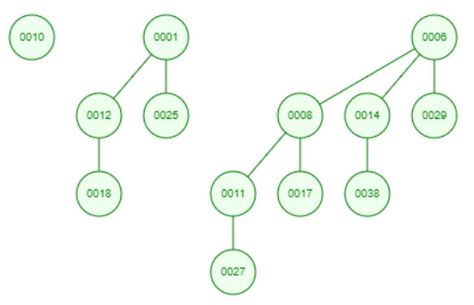
7. zadatak
Na slici je dat binomni hip. Nacrtati njegov izgled nakon dodavanja čvorova sa sledećim vrednostima 40, 11, 1, 9, 22, 34.
40
Head[H]

Slide 10
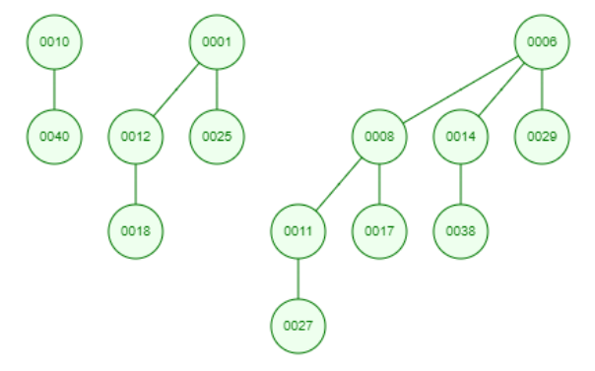
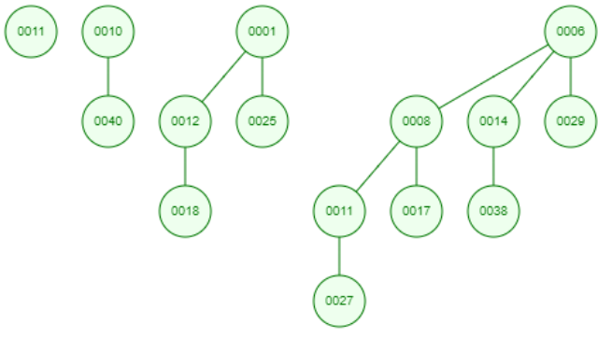
11
Head[H]
1
Head[H]

Slide 11
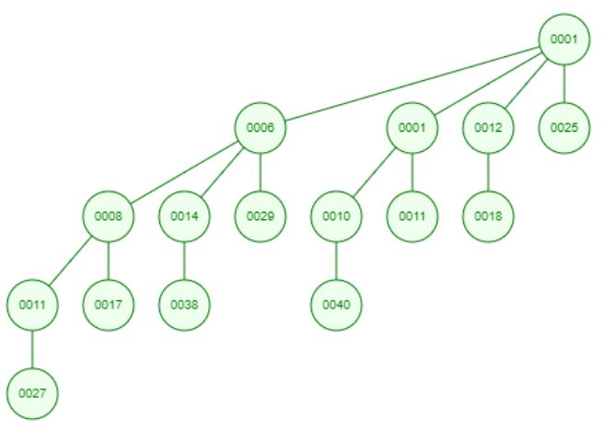
9
Head[H]

Slide 12
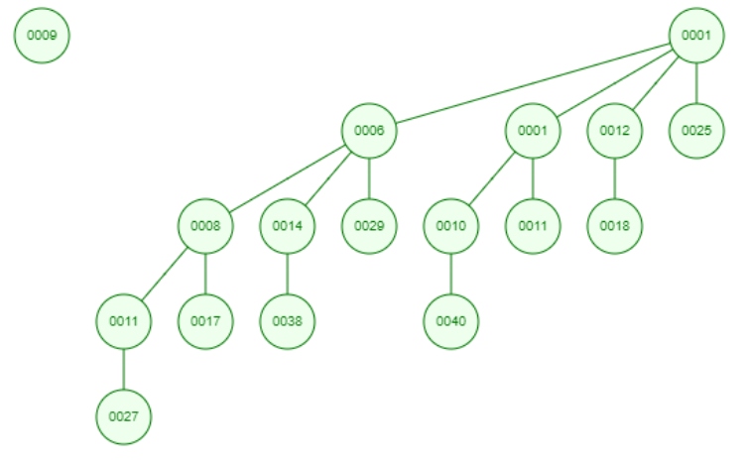
22
Head[H]

Slide 13
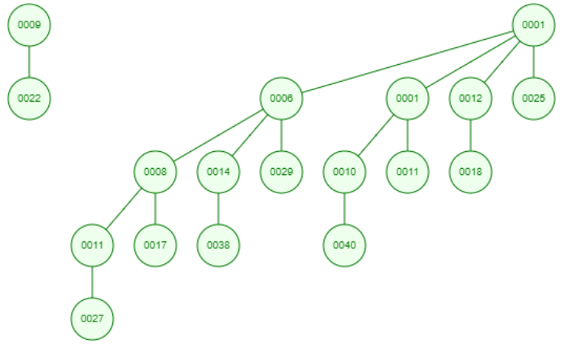
34
Head[H]

Slide 14
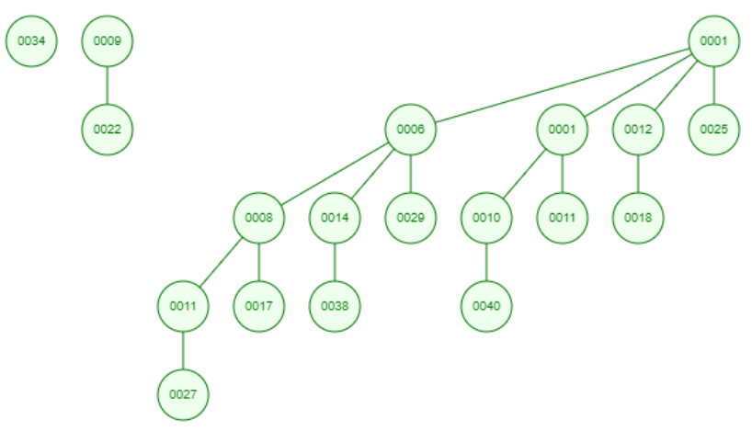
Head[H]

Slide 15
8. zadatak
Koristeći Huffman-ov algoritam kodirati reč: TOBEORNOTTOBEORTOORNOTSHAKESPEARE.

Slide 18
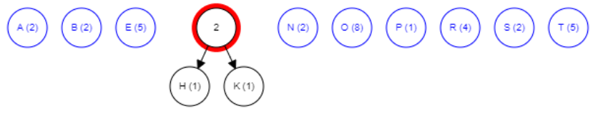

Slide 19
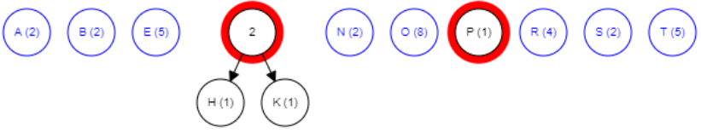

Slide 20
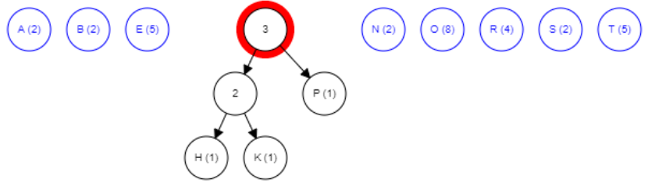

Slide 21
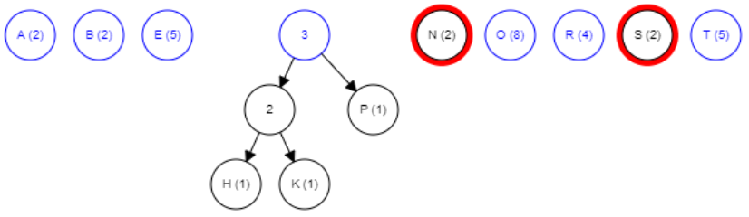

Slide 22
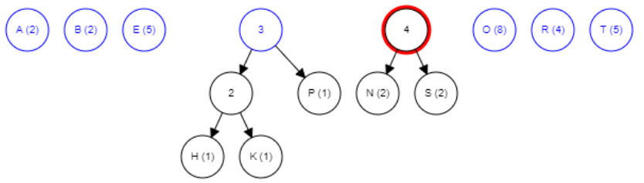

Slide 23
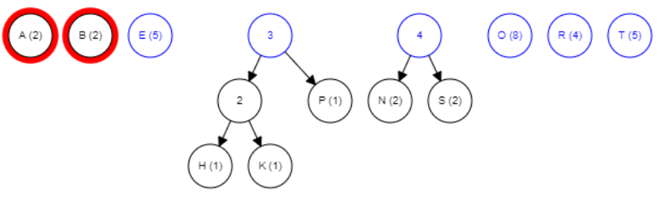

Slide 24
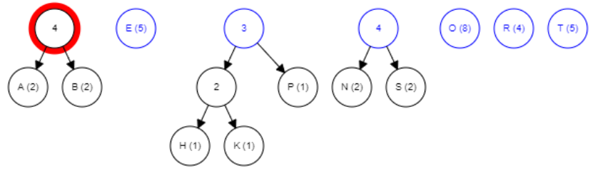

Slide 25
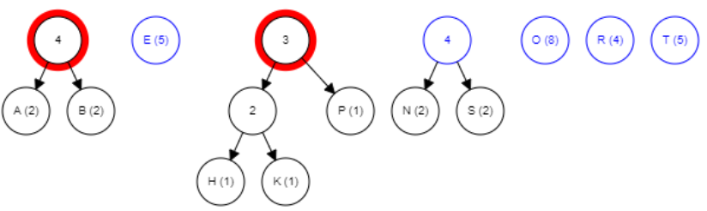

Slide 26
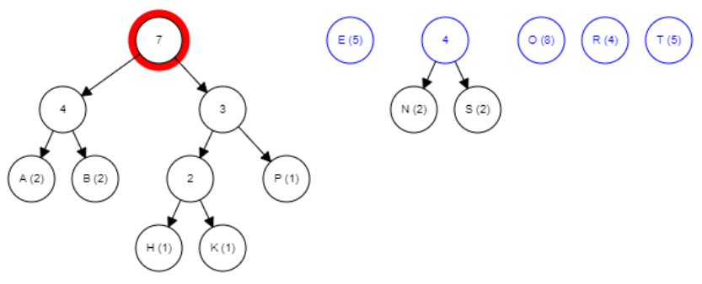

Slide 27
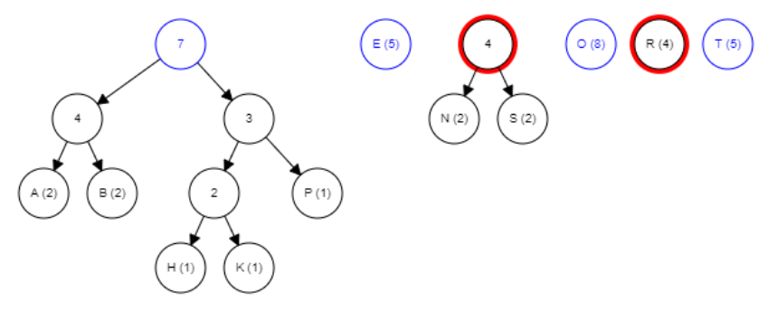

Slide 28
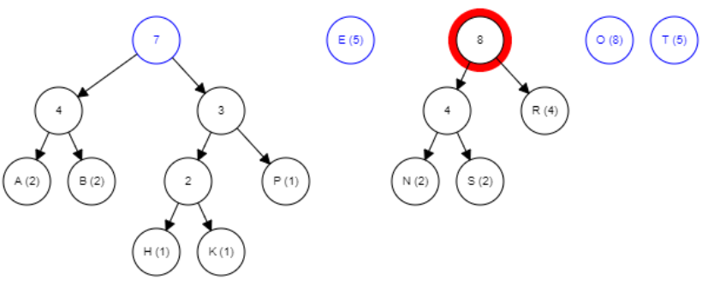

Slide 29
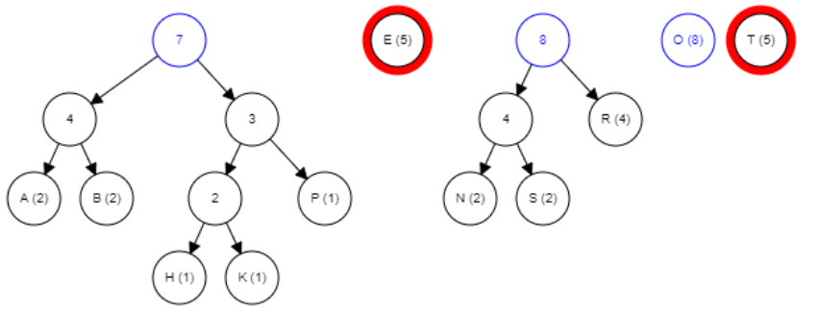

Slide 30
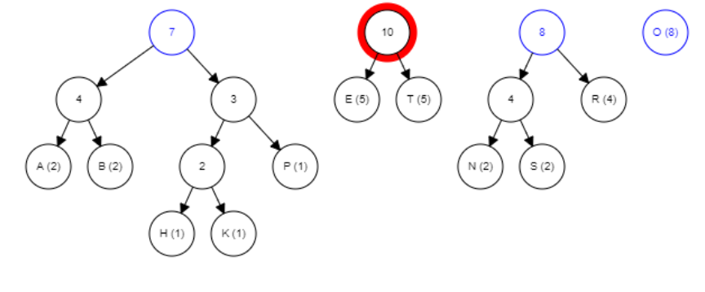

Slide 31
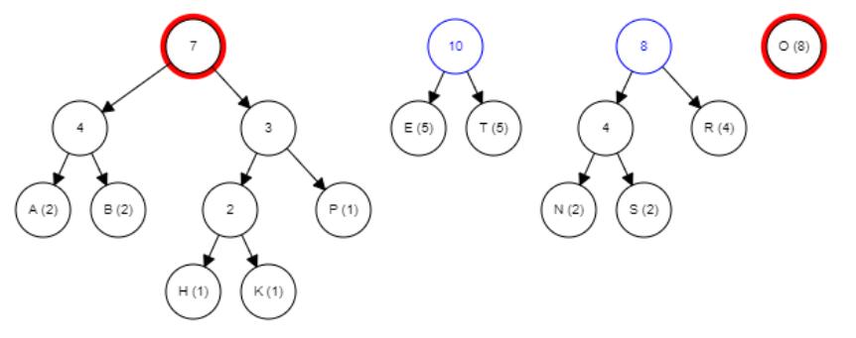

Slide 32
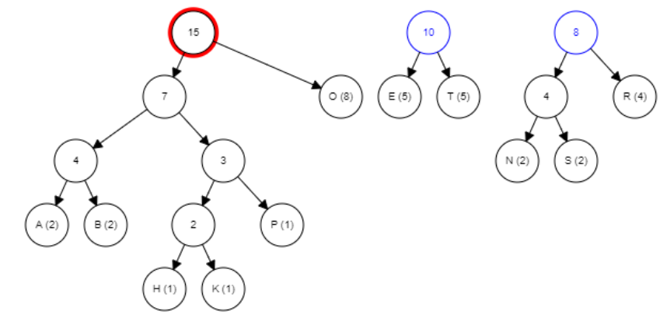

Slide 33
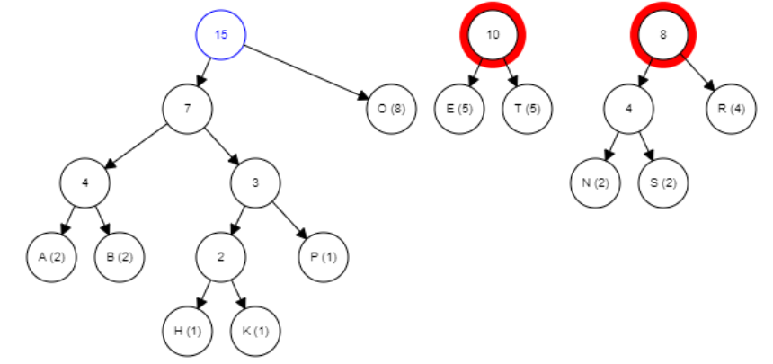

Slide 34
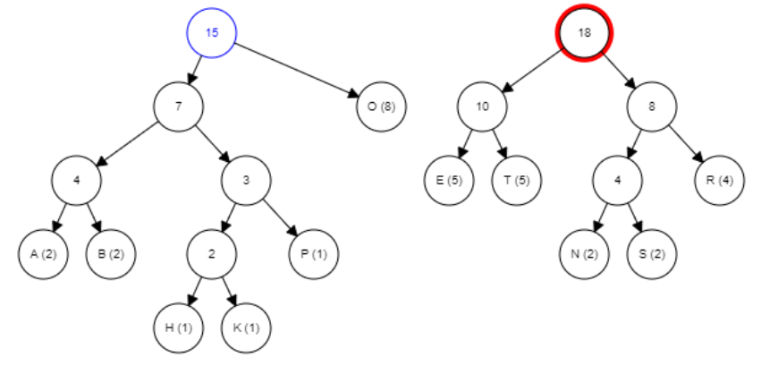

Slide 35
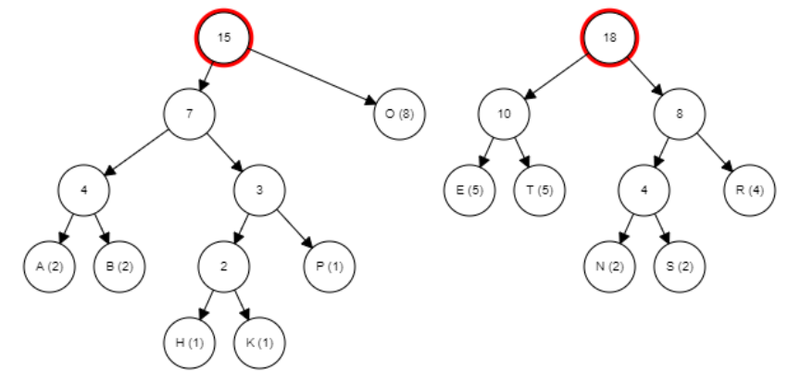

Slide 36
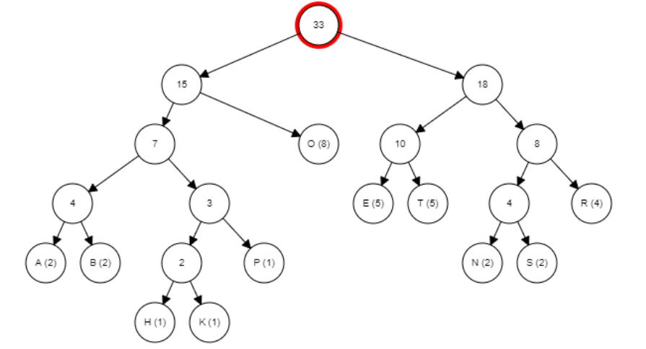
0
1
0
1
0
1
0
1
0
1
0
1
0
1
0
1
0
1
0
1
A-0000, B-0001, H-00100, K-00101, P-0011, O-01, E-100, T-101, N-1100, S-1101, R-111

Slide 37
A-0000, B-0001, H-00100, K-00101, P-0011, O-01, E-100, T-101, N-1100, S-1101, R-111
T O B E O R N O T T O B E O R T O O R N O T S H A K E 101|01|0001|100|01|111|1100|01|101|101|01|0001|100|01|111|101|01|01|111|1100|01|101|1101|00100|0000|00101|100
S P E A R E
1101|0011|100|0000|111|100

Slide 38
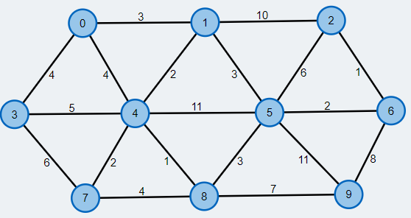
9. zadatak
Koristeći Primov algoritam naći minimalno sprežno stablo za graf prikazan na sledećoj slici:

Slide 39
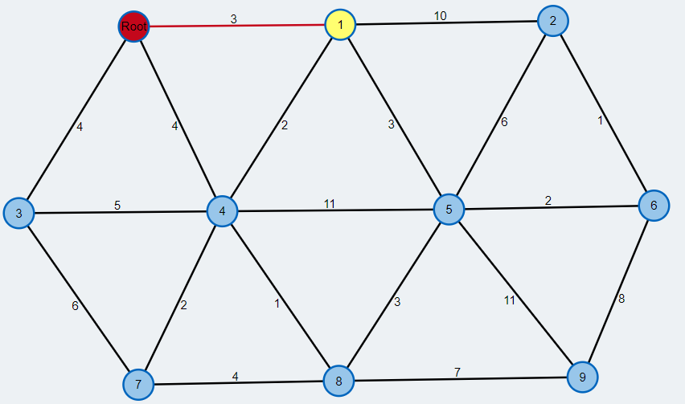
3
∞
∞
∞
∞
∞
∞
∞
∞

Slide 40
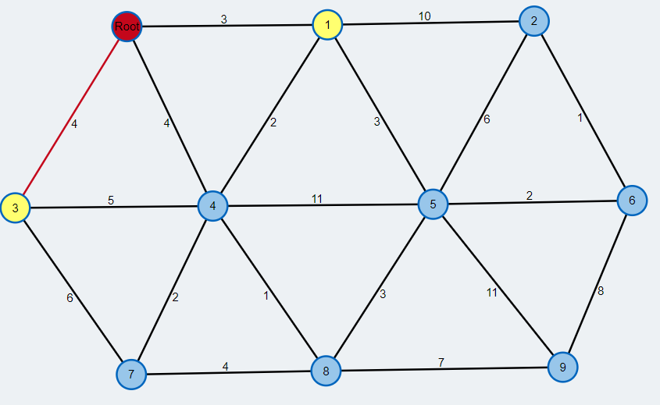
3
∞
∞
4
∞
∞
∞
∞
∞

Slide 41
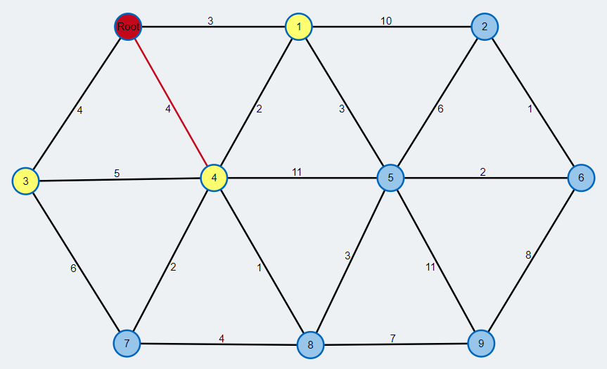
3
∞
∞
4
4
∞
∞
∞
∞

Slide 42
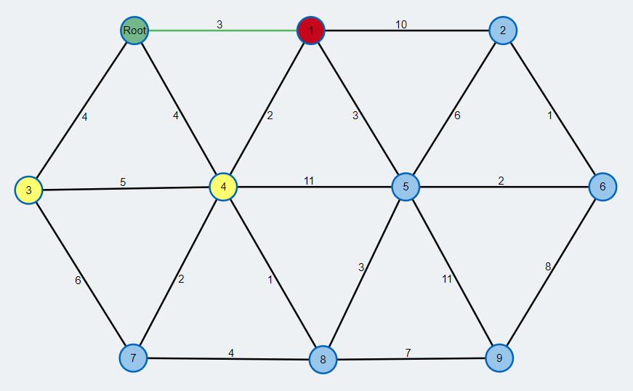
3
∞
∞
4
4
∞
∞
∞
∞

Slide 43
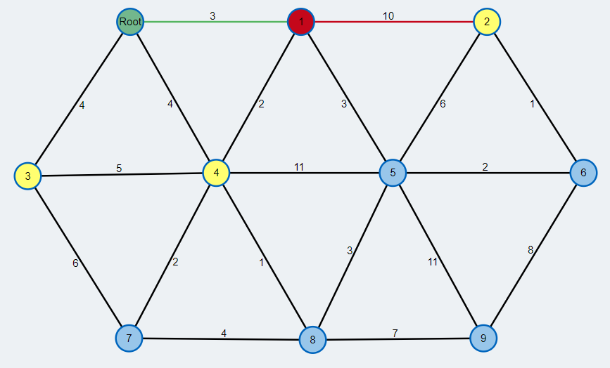
3
10
∞
4
4
∞
∞
∞
∞

Slide 44
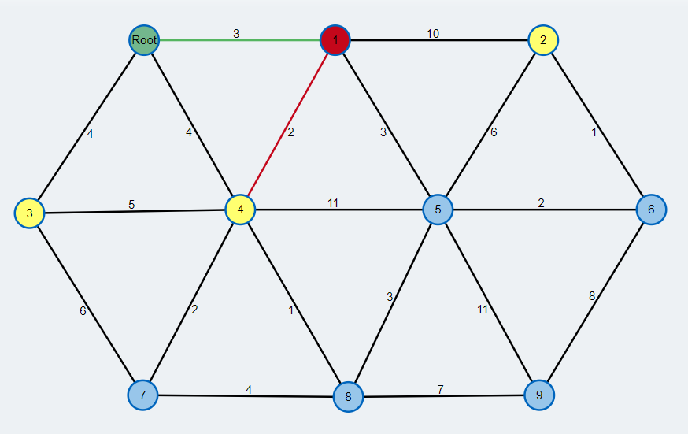
3
10
∞
4
2
∞
∞
∞
∞

Slide 45
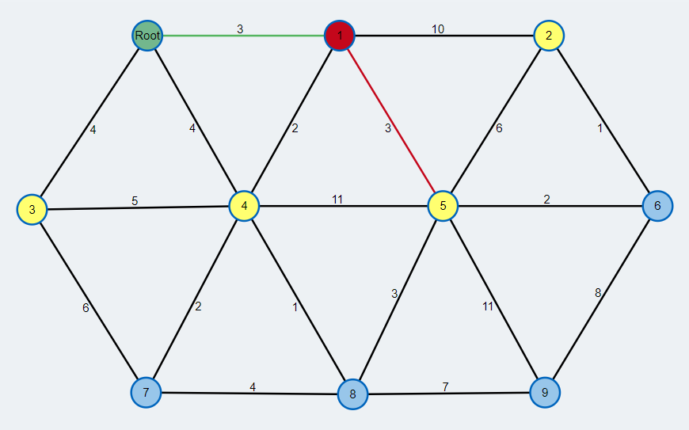
3
10
∞
4
2
3
∞
∞
∞

Slide 46
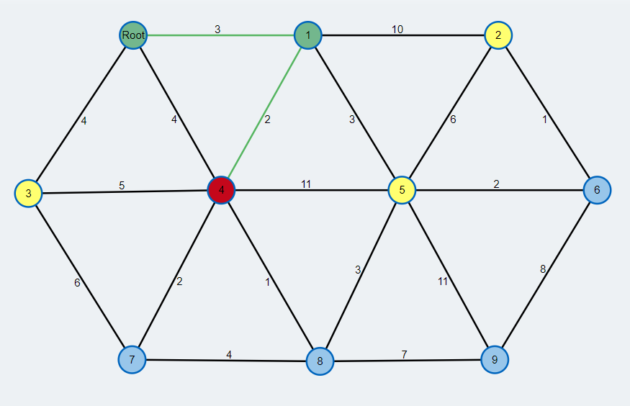
3
10
∞
4
2
3
∞
∞
∞

Slide 47
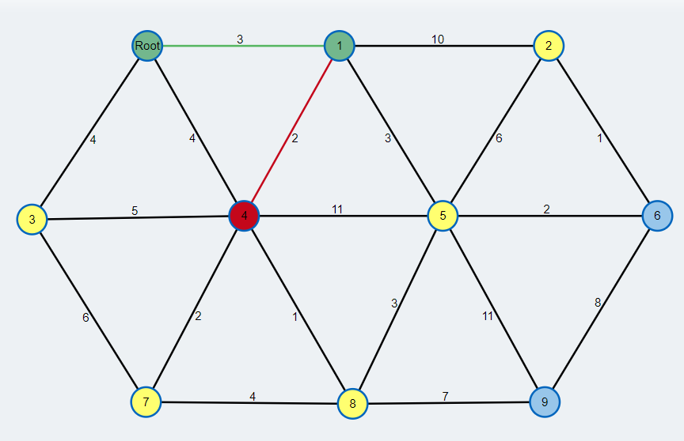
3
10
∞
4
2
3
2
1
∞

Slide 48
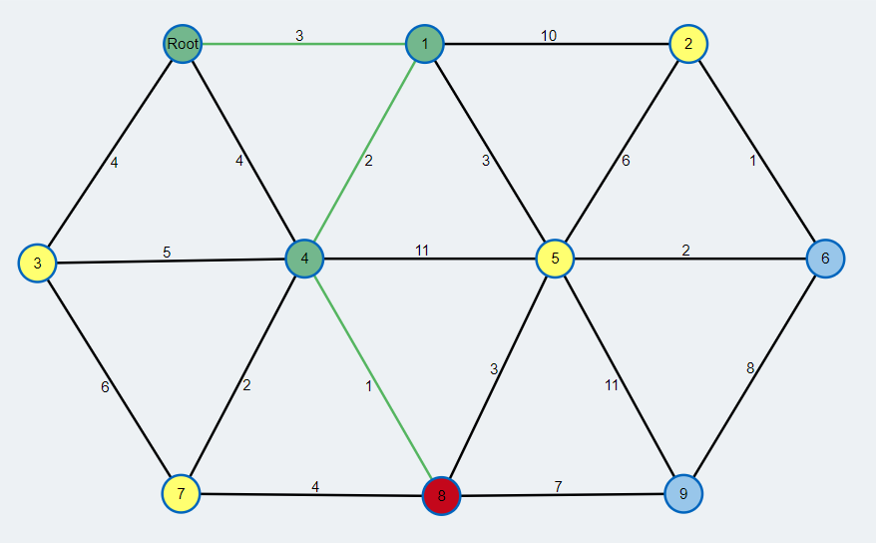
3
10
∞
4
2
3
2
1
∞

Slide 49
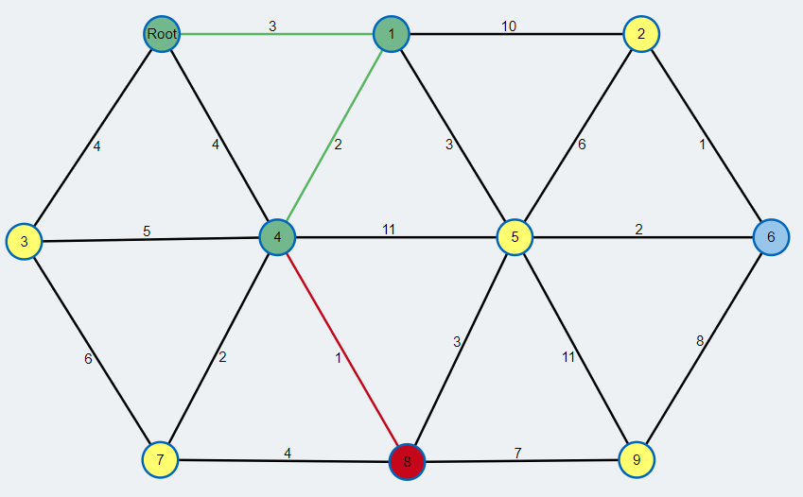
3
10
∞
4
2
3
2
1
7

Slide 50
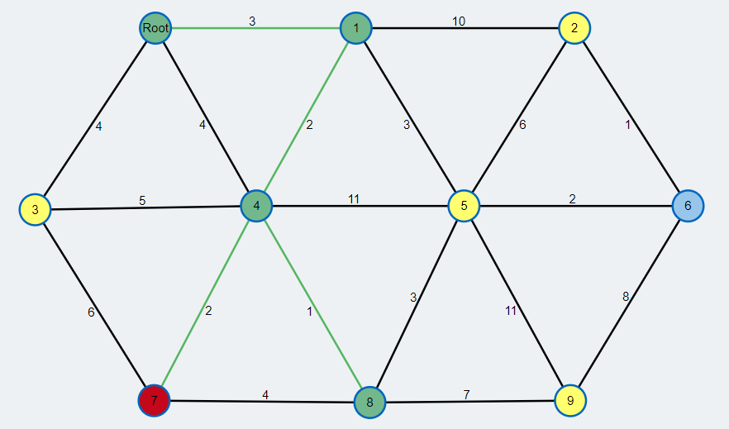
3
10
∞
4
2
3
2
1
7

Slide 51
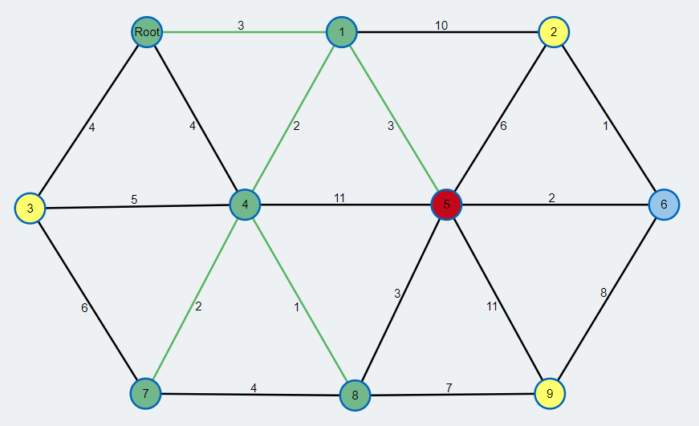
3
10
∞
4
2
3
2
1
7

Slide 52
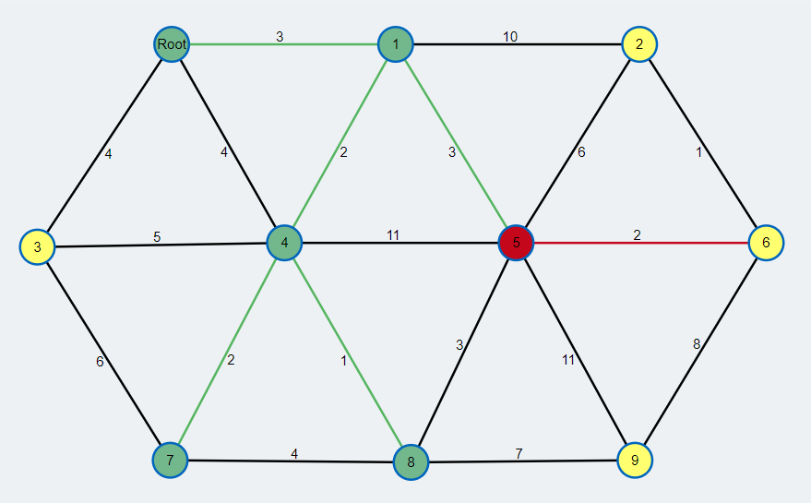
3
6
2
4
2
3
2
1
7

Slide 53
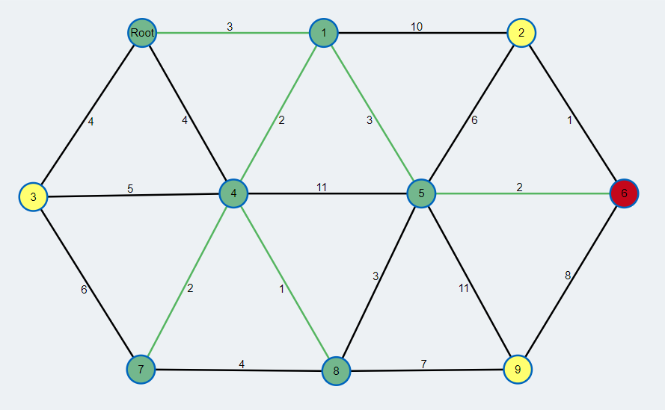
3
1
2
4
2
3
2
1
7

Slide 54
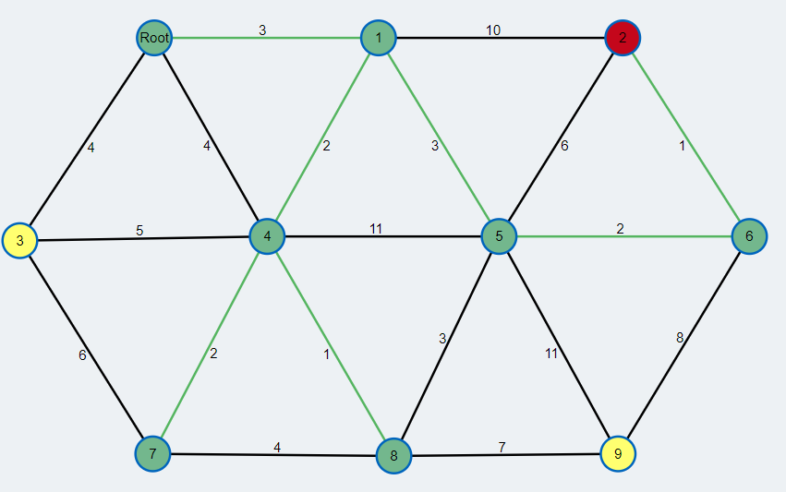
3
1
2
4
2
3
2
1
7

Slide 55
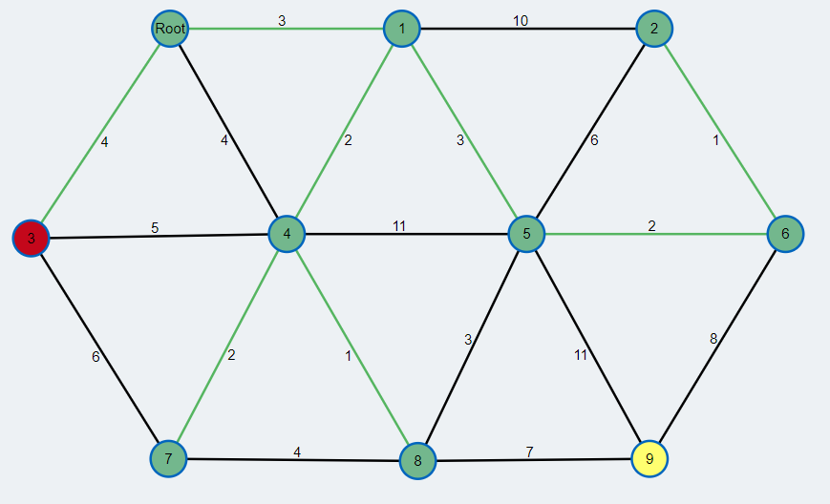
3
1
2
4
2
3
2
1
7

Slide 56
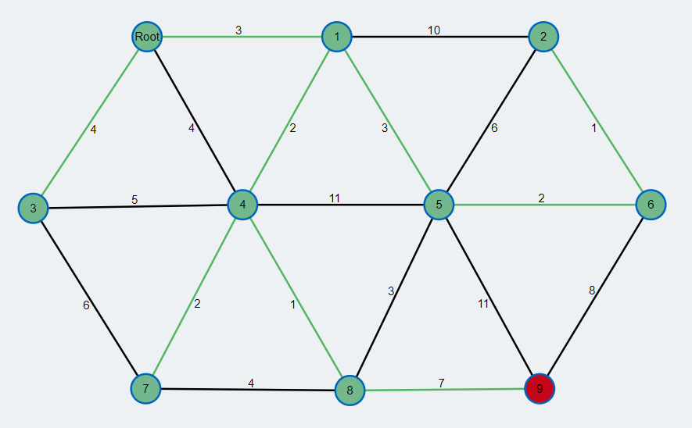
3
1
2
4
2
3
2
1
7

Slide 57
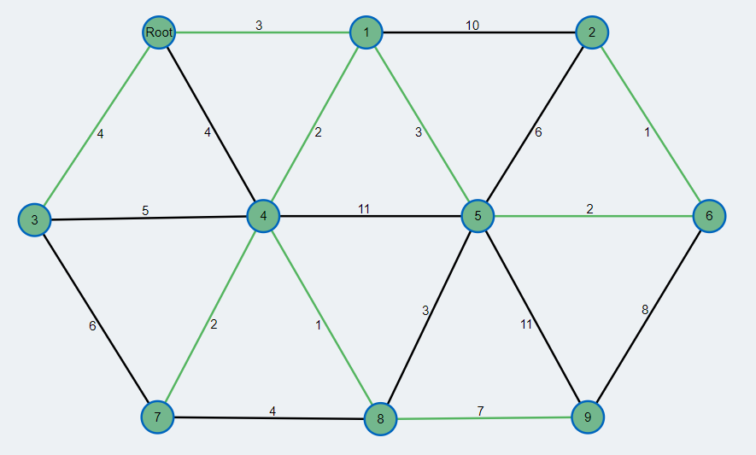
3
1
2
4
2
3
2
1
7

Slide 58
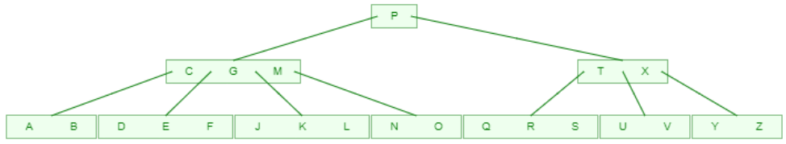
10. zadatak
Dato je B-stablo, u kome je maksimalan broj ključeva po čvoru 4. Nacrtati izgled stabla nakon što se u njega ubace H, I, W, a onda izbace G, P i T.
+ H

Slide 59
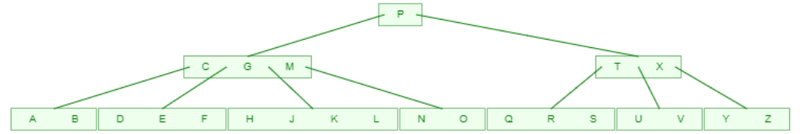
+ I

Slide 60
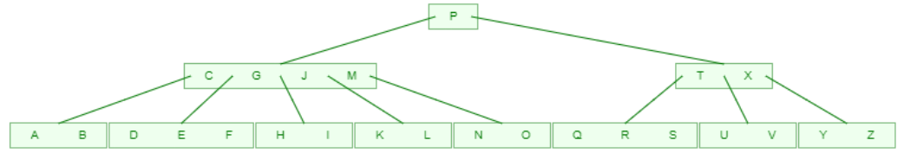
+ W

Slide 61
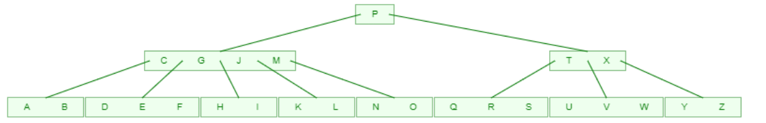
- G

Slide 62

- P

Slide 63

- T

Slide 64


Slide 65
1. zadatak
Opisati “Levu rotaciju” kod RB stabala.

Slide 66
x
y
levaRotacija(x)
A
y
x
C
B
C
A
B

Slide 67
Pretpostavlja se da je:
right[x] ≠ nil[T] i da je roditelj korena nil[T].
LEFT-ROTATE(T, x)
1 y ← right[x] // postavlja se y.
2 right[x] ← left[y] // levo podstablo od y postaje desno podst. od x
3 p[left[y]] ← x
4 p[y] ← p[x] // roditelj od x postaje roditelj od y
5 if p[x] = nil[T] // ako je x koren stabla
6 then root[T] ← y
7 else if x = left[p[x]] // da li je x levi ili desni potomak
8 then left[p[x]] ← y
9 else right[p[x]] ← y
10 left[y] ← x // levi potomak od y postaje x
11 p[x] ← y

Slide 68
2. zadatak
Izvršiti analizu složenosti algoritma „Merge sort“.

Slide 69
3. zadatak
Kolika je složenost rekurzivnog algoritma opisanog relacijom
T(n)= 4T(n/2)+n²

Slide 70
3. zadatak – Iterativni metod
T(n) = 4T(n/2) + n²
= 2² T(n/2) + n²
= 2² (4 T(n/4) + (n/2)²) + n²
= 2⁴ T(n/4) + 2²(n/2)² + n²
= 2⁴ T(n/4) + n² + n²
= 2⁴ T(n/2²) + 2n²
= 2⁴ (4T(n/8) + (n/2²) ²) + 2n²
= 2⁶ T(n/8) + 2⁴(n/2²) ² + 2n²
= 2⁶ T(n/2³) + 3n²
= 2⁶ (4T(n/2⁴) + (n/2³) ² ) + 3n²
= 2⁸ T(n/2⁴) + 4n²

Slide 71
3. zadatak – Iterativni metod
T(n) = 2^{2i} T(n/2^{i}) + i*n²
Pretpostavimo: n=2^{k}
lg n = k
T(n) = 2^{2k} T(n/2^{k}) + n²k
= 2^{2k} T(1) + n² lg n
= n² T(1) + n² lg n
= Θ(n²lgn)

Slide 72
3. zadatak – Master metod, slučaj 2
Case 2: if f(n) = Θ(n^{log}_{b}ª), then: T(n) = Θ(n^{log}_{b}ª lgn)
T(n)= 4T(n/2)+n²
a=4, b=2, f (n)=n²
log_{b} a = log₂ 4 = 2
f (n) = Θ ( n²) onda važi:
T(n) =Θ(n²lgn)
gde: a ≥ 1, b > 1, i f(n) > 0

Slide 73
4. zadatak
Izračunati minimalnu cenu i optimalan redosled množenja matrica A1*A1*A3*A4*A5
A1(10 × 25)
A2(25 × 14)
A3(14 × 15)
A4(15 × 12)
A5(12 × 20)

Slide 74
5. zadatak
Napisati pseudokod funkcije „OS-select“.

